Slide 1
Faraday Golfing Machine U1C6

Slide 2
1.6 Faraday Golfing Machine
Overview:
This lesson gives students an opportunity to build a relatively complex structure from the NXT kit that uses a wide variety of components (the 9797 kit soccer/golf attachment). Students are then introduced to Faraday's Law and use this knowledge and their structural building skills to create a Faraday Golfing machine.
Objectives:
Students will be able to:
1. Describe examples of how robotics components interact to achieve desired functionality
2. Explain Faraday's Law
3. Build an NXT-based golfing machine

Slide 3
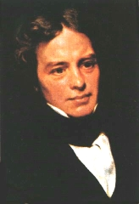
Faraday’s Law
Any change in the magnetic environment of a coil of wire will cause a voltage to be in the coil. No matter how the change is produced, the voltage will be generated. The change could be produced by changing the magnetic field strength, moving a magnet toward or away from the coil, moving the coil into or out of the magnetic field, rotating the coil relative to the magnet, etc.
V - Voltage generated
B - Magnetic flux
t – Time
A - Area of the coil
N - Number of turns
Michael Faraday
Faraday’ s Law Animation
Generator Animation
Notes:
Michael Faraday discovered that above process could be reversed.
In the case of the remote control generator, Faraday's Law converts kinetic energy (motion) into electrical energy (current)
The Faraday's Law Animation link [13] goes to an interactive animation site. The user can click on the bar magnet and move it through the loops of wire. When this happens, a current is generated in the wire as can be seen by the meter moving and the lamp illuminating.
the lamp will illuminate when the magnet is move in either direction, but the meter shows the current actually switching direction with the movement
note too, that the intensity of the light and the level shown on the meter increase with the speed at which the magnet is moved through the loop
The Generator Animation link [14] also goes to an interactive animation site. Here again, we have and outer fixed magnet and an inner rotating electromagnet. This time, however, the orange handle on the rotating electromagnet is turned (like turning the orange hub on the NXT motor) and electricity is produced in the wire loop. Select the "With Commutator" option and move the "rot/min" slider to show how the level of electrical current increases with the speed of rotation of the orange handle.
Have students build an handle of their choice onto the orange hub of a second motor (turning this handle/hub will cause the soccer/golf attachment to “swing”. Be sure to attach the crank to the orange hub with more than a single axle (use some of the four round connector points on the orange hub) or else the force of turning the crank may bend/damage the lone axle.

Slide 4
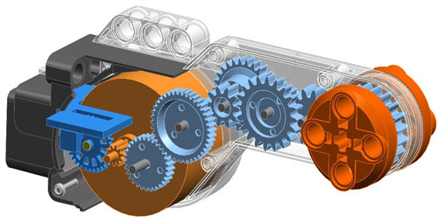
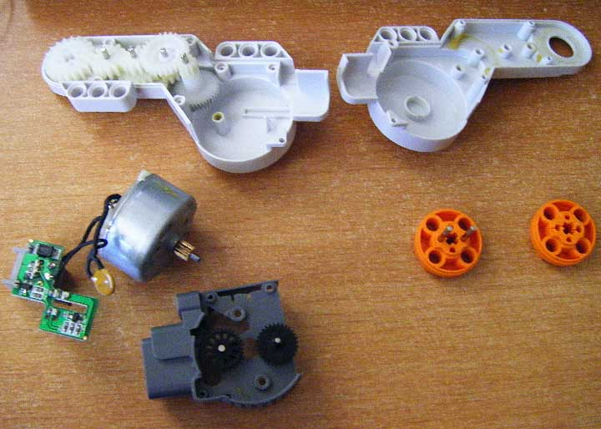
NXT Motor –Inside
Motor >>
Electromagnet
Motor Animation
Notes:
The illustration shows the inside of an NXT motor with its internally gearing.
The photo shows the round metal motor that drives the gears.
Have students connect soccer attachment motor directly to a second motor using a wire:
The second motor will act as a generator and creating an electric current that cause the soccer/golf attachment to move. The is the Faraday Principle at work (named after Michael Faraday, the scientist, not Daniel Faraday, the character on "Lost")
A light cable and lamp can be attached to a lone motor to demonstrate for students how the motor can act as a generator by turning the orange hub and watching the lamp illuminate.
In the case of the Golfing Attachment motor, electrical energy (current in the wires) is converted into kinetic energy (motion)
The Electromagnet link [11] show an photo and illustration of a simple electromagnet using a battery, loops of wire and an iron nail:
Ask students if they have built an electromagnet like this in early science classes
The Motor Animation link [12] shows a video animation of how motor works. An outer fixed magnet (blue) creates a constant magnetic filed between its north and south poles. An inner rotating electromagnet (green battery, yellow loop of wire) also produces a magnet filed which turns the loop in an attempt to align with the N/S field of the fixed magnet. However, just when the fields are nearly aligned, the direction of the current through the loop reverses (red line on yellow loop base), so the electromagnet field also reverse and rotating loop attempts to align in the opposite direction. By constantly switching the direction of the current every half-turn, the motor turns constantly as it "chases" the fixed magnet field.

Slide 5
Faraday Golfing Machine
We’ll start by building this golfing attachment
(pg 46/50):
Then build a frame structure to support it
remember how to build strong shapes?
Then build a wired-remote control using Faraday’s Law
Notes:
Students begin with the Golfing Attachment which they just completed.
They will then need to build a self-supporting frame/structure to support this attachment with a size/height sufficient to allow it to strike an NXT red or blue ball on a tee
a roll of tape makes a great tee
have student recall the lesson previous lesson on building strong structures
Finally, they will need to build a remote control to operate their Golfing Machine. This control will take advantage of Faraday's Law to eliminate the need for a batteries.

Slide 6
Faraday Golfing Machine Build Instructions
Build the soccer/golf attachment from their NXT kit instructions
(9797 Manual, p.46/50).
Students take notice of the following:
The instructions contain no words; Why?
The shaded blue box lists all the parts needed for the next step:
To improve building efficiency, one student find the next parts, the second student complete the building steps and then the third (or first) student check the built product versus the illustration before advancing to the next step.
Switch roles every page, so all students get practice building
A full scale illustration of each axle and the longer beams are included on each page to verify the component size before beginning construction
On newer kits (9797, version 95 [book #6030357 vice 45000569]), the inside of the manual front cover contains an illustration of the components which have changed shape or color from the original 9797 kit (ver 46). The construction illustrations represent the original kit components, so students using the new version 95 kit may be confused by discrepancies between the illustrations and the components in their kits.
Notes:
Have students build the soccer/golf attachment from their NXT kit instructions (9797 Manual, p.50).
Have students take notice of the following:
The instructions contain no words; ask students why? (same instructions used in many countries/languages).
The shaded blue box lists all the parts needed for the next step:
To improve building efficiency, have one student find the next parts, the second student complete the building steps and then the first student check the built product versus the illustration before advancing to the next step.
Have students switch roles every page, so both students get practice building
A full scale illustration of each axle and the longer beams are included on each page to verify the component size before beginning construction
On newer kits (9797, version 95), the inside of the manual front cover contains an illustration of the components which have changed shape or color from the original 9797 kit (version 46). The construction illustrations represent the original kit components, so students using the new version 95 kit may be confused by discrepancies between the illustrations and the components in their kits.

Slide 7
9797 Book conventions
On newer kits
(9797, version 95
[book #6030357 vice 45000569]), the inside of the manual front cover contains an illustration of the components which have changed shape or color from the original 9797 kit
(ver son 46).

Slide 8
9797 Book conventions
The instructions contain no words; Why?
The shaded blue box lists all the parts needed for the next step:
A full scale illustration of each axle and the longer beams are included on each page to verify the component size before beginning construction

Slide 9
Faraday Golf Tournament Rules
Build a tee (The large tire that comes with the kit works great for a tee and every group has one.) on a flat surface at the bottom of, and another flat surface beyond the top edge of the ramp. Create a hole-in-one target area on the flat surface beyond the ramp.
A Task Assignment [15] sheet for this challenge is included in the Summative Assessment.
A Driving Range competition can also be added where teams see how far they can hit the ball on a carpeted floor.
Notes:
Faraday Golf Tournament Rules
For the golf challenge, prop up a 4'x4' board on a up-right 2x4 (3.5“ high) at one end. Have students hit the ball up the incline - full points if they get it to drop off, and bonus if they hit a target. The tee can a roll of tape, the large wheel hub, or anything else the student wants. Golf machine and tee should be on level ground at bottom of 4'x4' ramp.
Create a hole-in-one target area on the flat surface beyond the ramp.
Build ramp with a tee (The large tire that comes with the kit works great for a tee and every group has one.) on a flat surface at the bottom, and another flat surface beyond the top edge of the ramp. Create a hole-in-one target area on the flat surface beyond the ramp.
A Task Assignment [15] sheet for this challenge is included in the Summative Assessment.
A Driving Range competition can also be added where teams see how far they can hit the ball on a carpeted floor.

Slide 10
Faraday Golf Tournament Rules
As a team, work to develop and demonstrate a wired-remote-control Faraday Golf Player:
(2 pts) Build the golfing attachment shown beginning on page (46/50) of your NXT manual
(2 pts) Build a supporting structure for this attachment which allows you to strike the ball on the tee. The total height of build, less than 5 1/4”.
(2 pts) Build a wired-remote-control using a second motor:
>> connect to the golfing attachment with the longest (50cm) Cord. >> attach a “handle arm” to the orange motor hub at a minimum of 2 points >> do not use 13 or 15 hole beams for the remote control handle arm.
(2 pts) As you test your evolving design, on the back of this page describe what happened when you tested it and what you changed to improve it (list a minimum of 4 tests/changes)
Each team will have two attempts to demonstrate their solution (each team member takes a turn)
(2 pts) While holding only the remote control, strike the ball from the tee
(2 pts) Strike the ball hard enough to go off the top of the ramp
(Bonus: 1 pt) Score a hole-in-one

Slide 12
Just for fun – The Driving Range!
The Driving Range is an extension exercise for those who finished the Golf Tournament challenge - it is a "see who can hit it the farthest" exercise.
Go into the supply room and “golf” from the red tape.
Mark your farthest straight shot to where the ball stops or hits the wall (not after bouncing off anything) with a 1” square of masking tape and mark with your team # (i.e. 2A or 3C)

